Slide 1
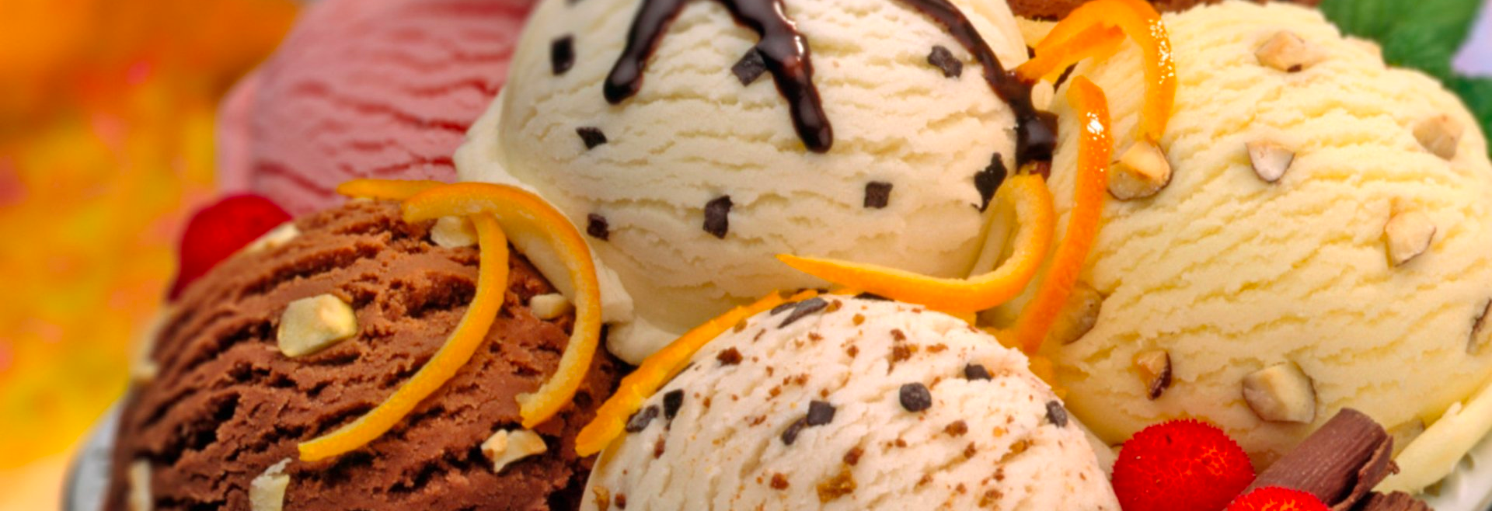
Yelp Reviews on Ice-cream Shops
STAT 628, Module 3
Group3: Ke Chen, Nan Yan, Chen Hu, Richard Yang

Slide 2
Goals
To construct score-prediction model for shop owners
How can an existing shop improve its score
How should a ‘startup’ arrange its facilities
To find influencing factors of success for ice cream shops
To provide specific suggestions for each city
Most popular shop, flavor, topping in a city

Slide 3
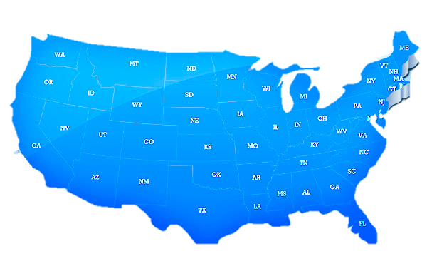

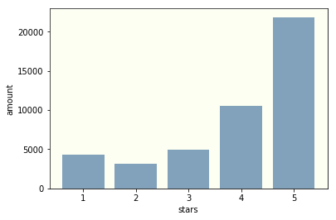
Dataset
455 ice cream shops with 45k reviews
6 target cities in the U.S.:
Las Vegas, Phoenix, Charlotte, Pittsburgh, Madison
Score distribution
Mean score: 3.95 (Pretty high)
Median score: 4

Slide 4
Score Prediction (Outline)
Predict business stars based on attributes it have
Steps:
Calculate users’ faithfulness weight (provide trustful users higher weight )
Compute new weighted score based on users’ weight
Construct multivariate linear model to predict the weighted score
Find factors of successful ice cream business

Slide 5
Users’ Faithfulness Prediction
Model: Logistic Model to predict the probability of being a faithful user
Variables: # fans, # friends, # useful reviews, etc.
Provide reviews from faithful users with higher weight

Slide 6
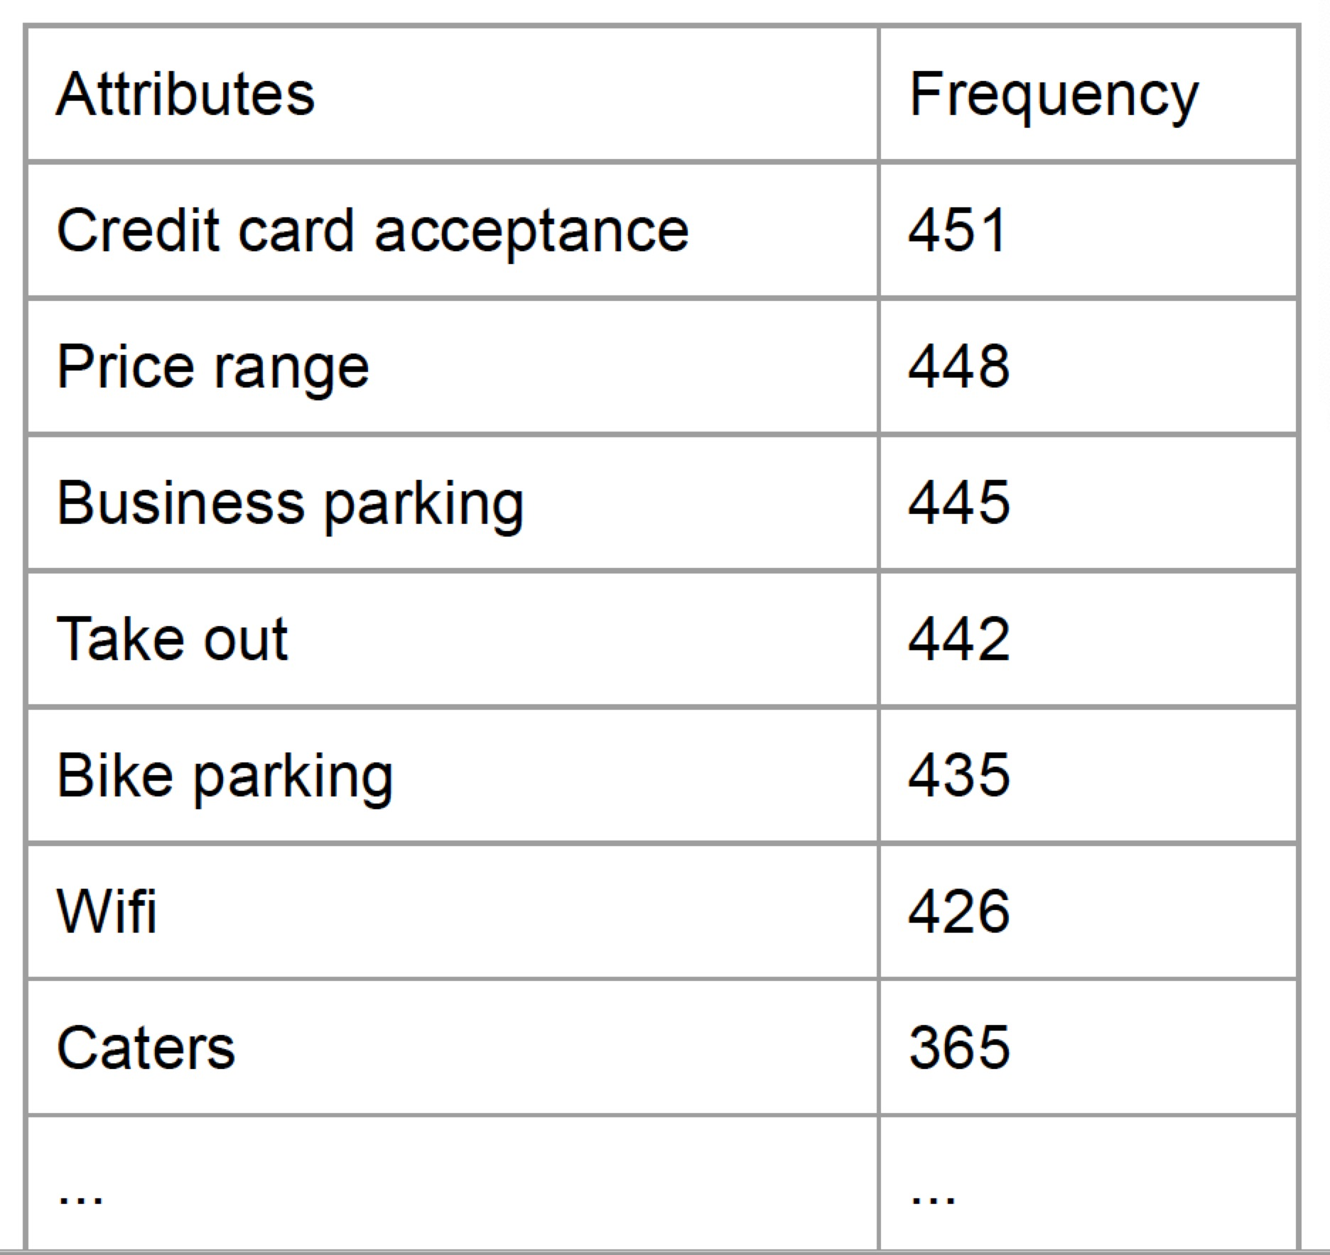
Missing value in attributes
Dropping variables: If frequency < 100.
Randomly replace NA with values proportionally to not NA values: If t-test for testing mean stars of shops provide this attribute equal to that of shops don’t provide it is not significant.
Impute NA by KNN with predictors ‘stars’ and ‘review count’ : If t-test for testing mean stars of shops provide this attribute equal to that of shops don’t provide is significant.
Notes:
Assign NA randomly with different values in proportion with known sample distribution of this attribute

Slide 7
Reduce categories in attributes
Merge some categories: If Tukey test to test difference in pairwise categories is not significant
Cut continuous variables into categorical: seek optimal cut points for open time, close time and business time.
Notes:
Assign NA randomly with different values in proportion with known sample distribution of this attribute

Slide 8
Score Prediction
Linear model: predict the score of a shop given attributes it have
(continuous response)
Round the predicted stars to integer , ‘misclassification rate’ is 31%
Classification tree model: (categorical response)
‘misclassification rate’ is 29%
Linear model is more interpretable

Slide 9
Suggestions
Attribute | coefficient | Attribute | coefficient
Takeout | 0.25 | Good for group | -0.35
Quiet | 0.16 | Weekday close after 11 | -0.10
reservation | 0.01 | Weekend close after 11 | 0.28
Wheelchair | 0.01 | Weekend business time last over 11h | 0.25
Credit card | 0.04 | Bikeplace | -0.1
Delivery | 0.24
Notes:
No caterings nor TVs
Don’t be too noisy, no group activities
Basic service are expected to be provided
Close after 11:00 pm at weekends

Slide 10
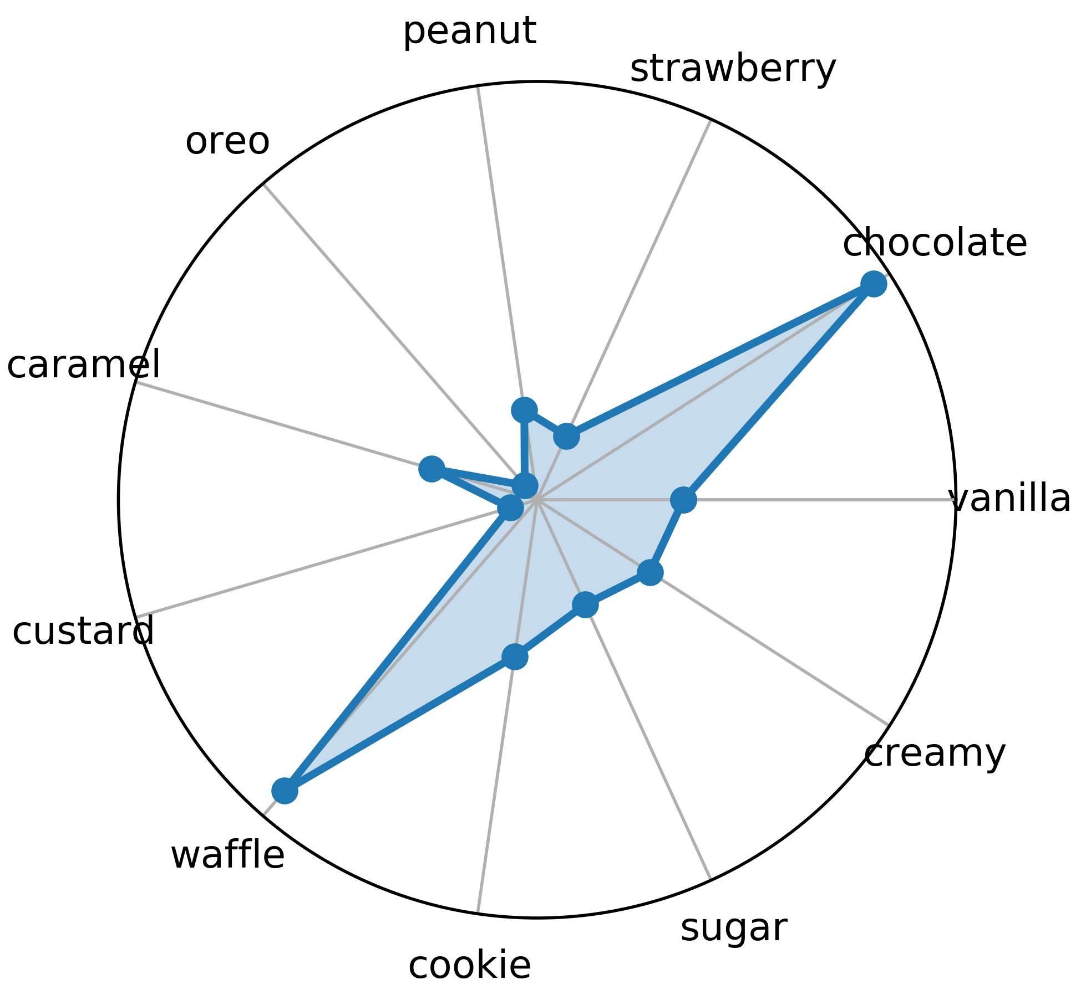
Review Analysis of Flavor
Popular Flavor
Word frequency analysis
Decision Tree: choose word with more power of distinguishing scores of reviews
People talk more often about these flavors indicating they order them most and concern more about their taste
Flavor Recommendation
Favorable Rate: word frequency in positive reviews (score = 4, 5)
Make comparisons among each cities
E.g. We recommend people to try chocolate and waffle in Pittsburgh
chocolate
waffle
Favorable Rate in Pittsburgh

Slide 11
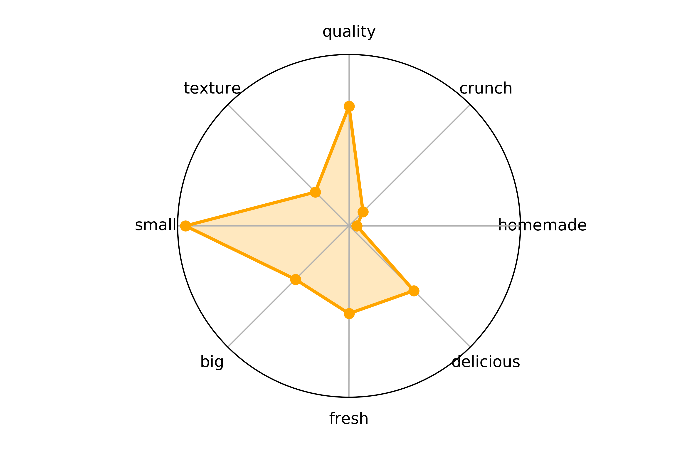
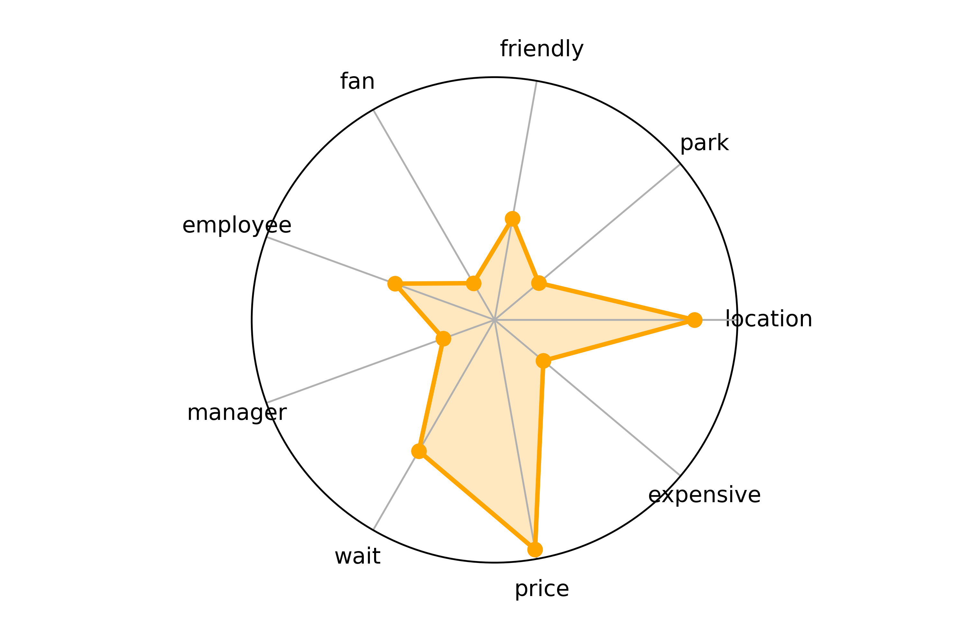
Review Analysis of Property & Service
Improvement Advice
Most frequent words of property & service in negative reviews (score = 1,2,3)
e.g. Advice for Shops in Madison
Ice cream property: size, quality, freshness, taste
Shop service: price, location, waiting time
Negative Comment of Property
Negative Comment of Service

Slide 12
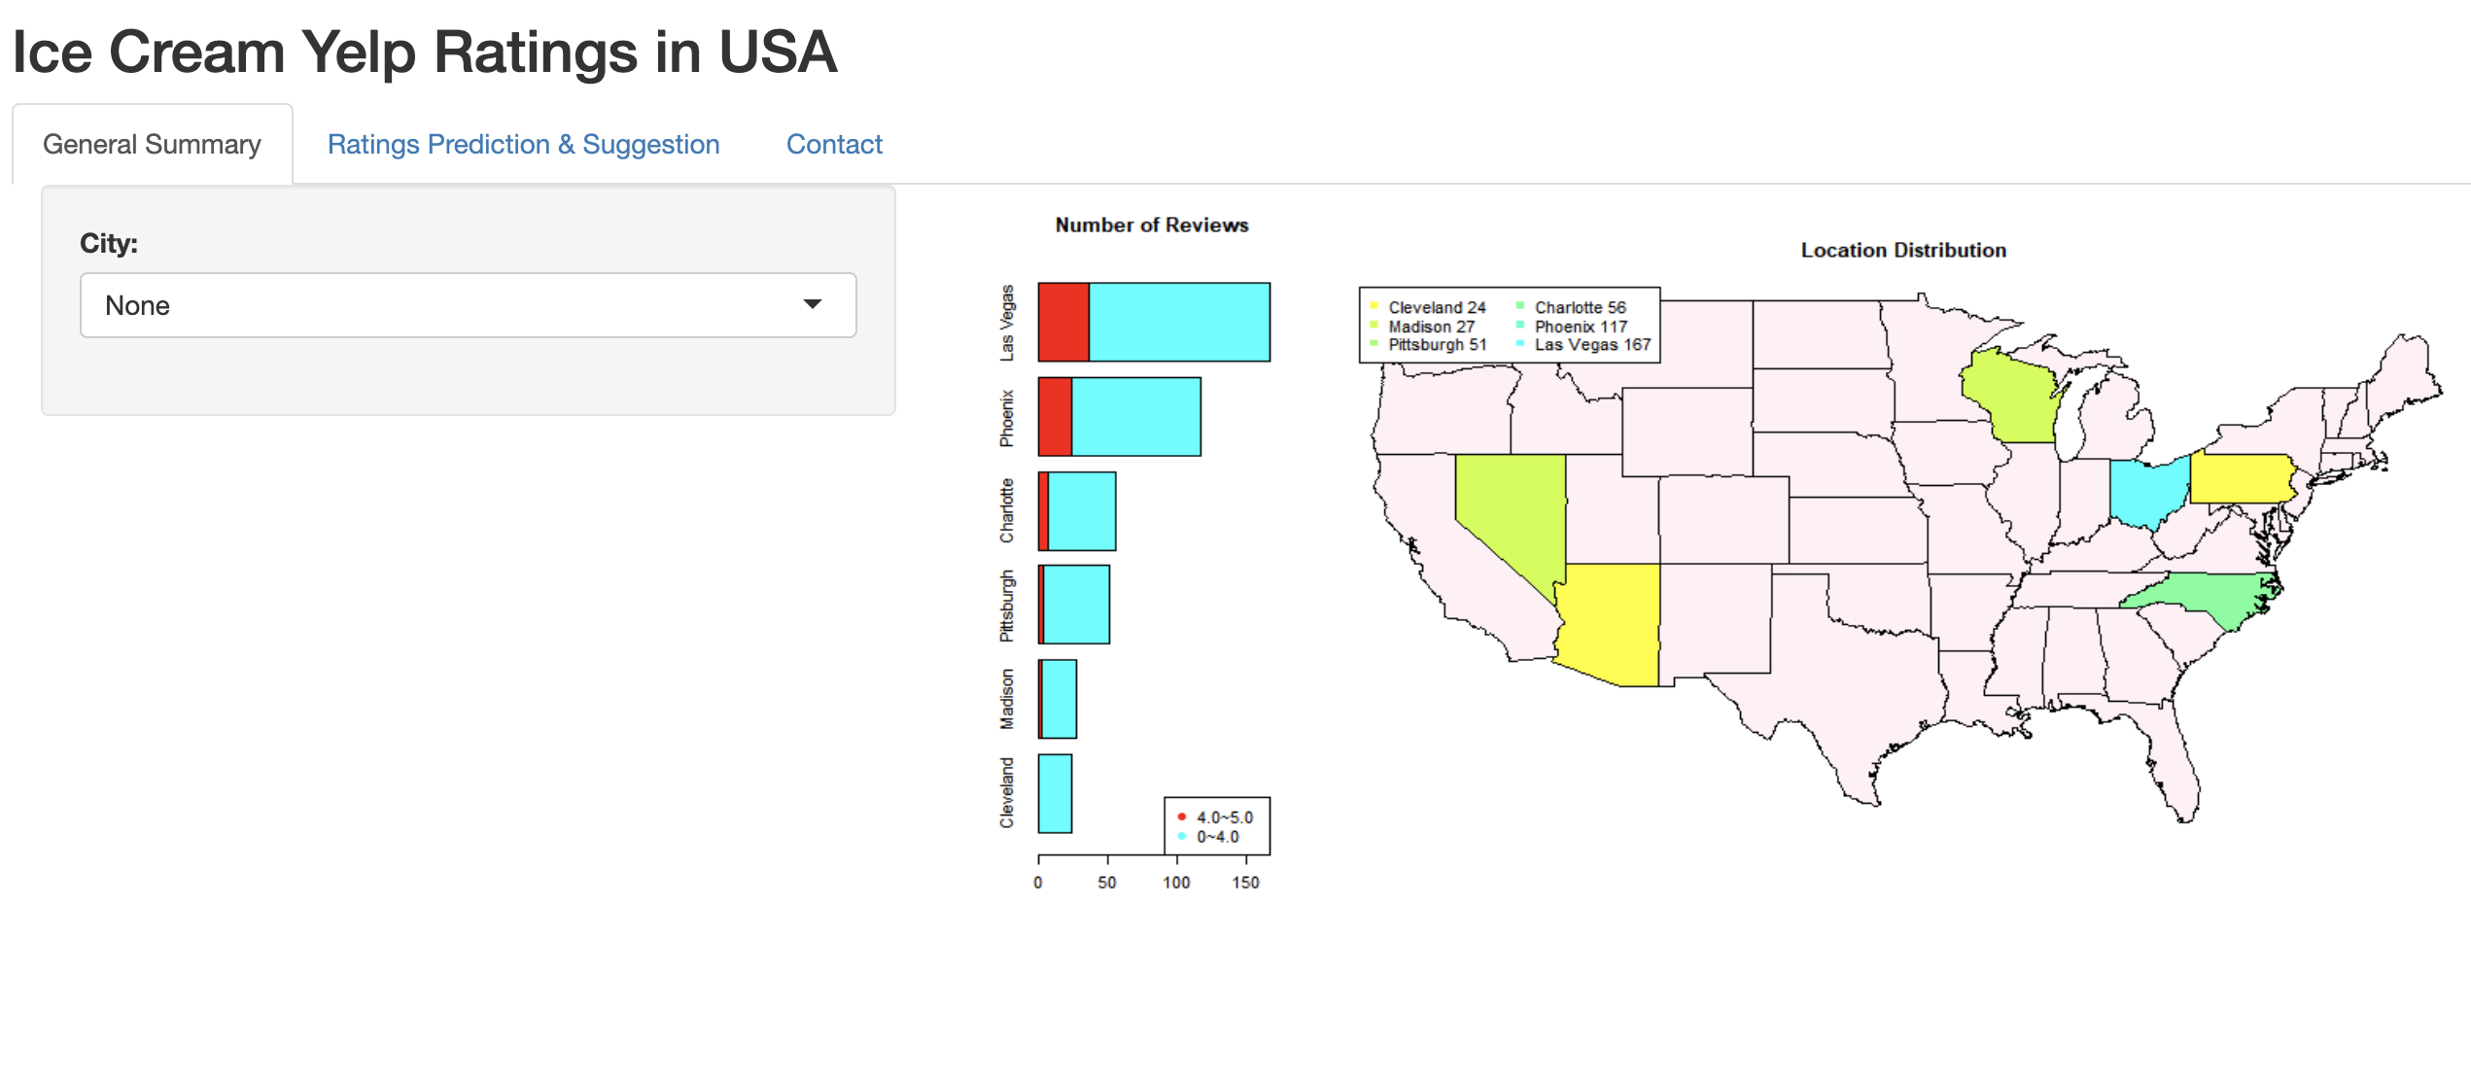
Conclusion (Shiny App)
Map of target cities
Number of reviews for each cities
Positive reviews vs. negative reviews (shops in southern part has higher score)

Slide 13
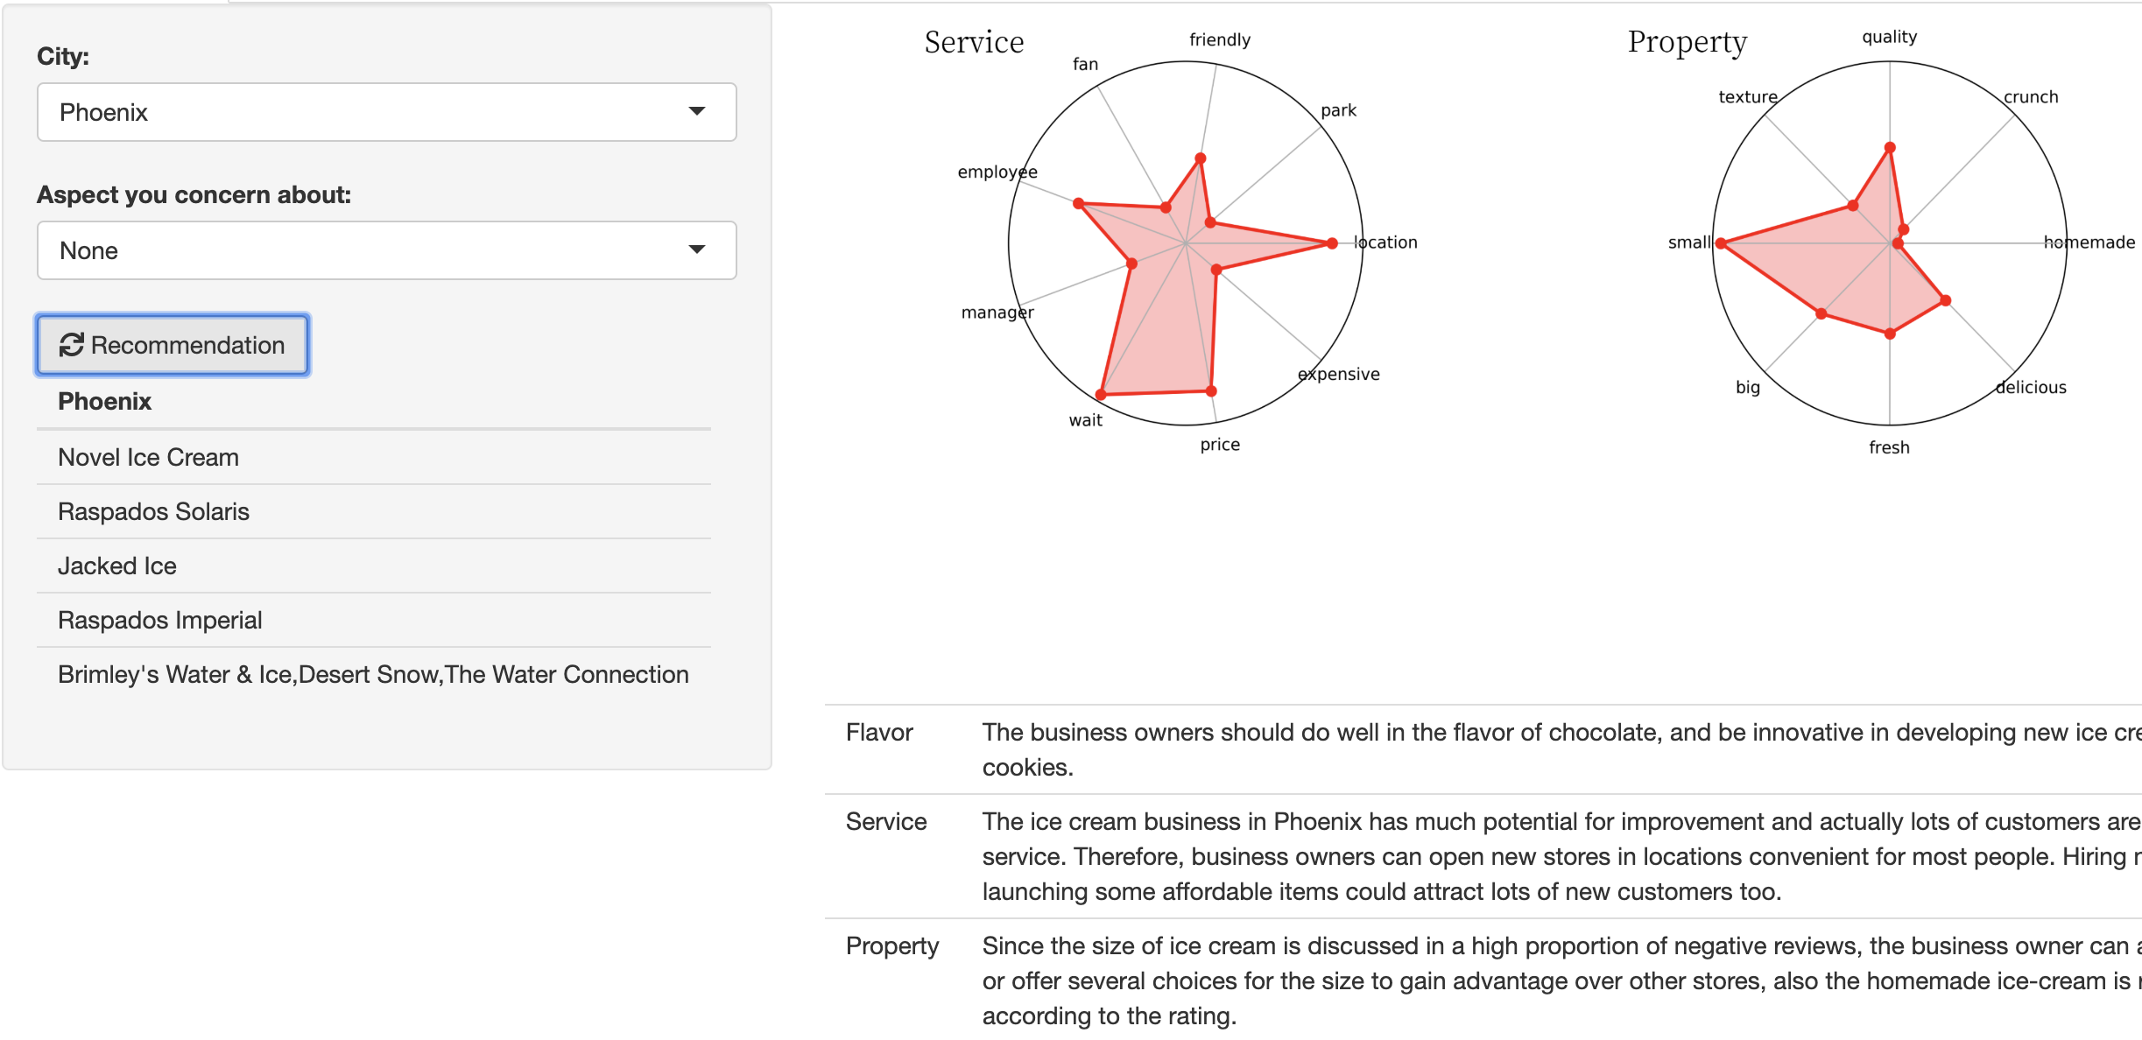
Conclusion (Suggestions)
Flavor: The business owners should do well in the flavor of chocolate and be innovative in developing new ice cream accompanied by cookies.
Service: The ice cream business in Phoenix should pay attention to service. Owners can open new stores in locations convenient for most people. Hiring more staff and launching some affordable items could attract lots of new customers too.
Property: Since the size of ice cream is discussed in a high proportion of negative reviews, the business owner can advertise their big size or offer several choices for the size to gain advantage over other stores, also the homemade ice-cream is popular according to the rating.
Shops that you should never miss!!!

Slide 14
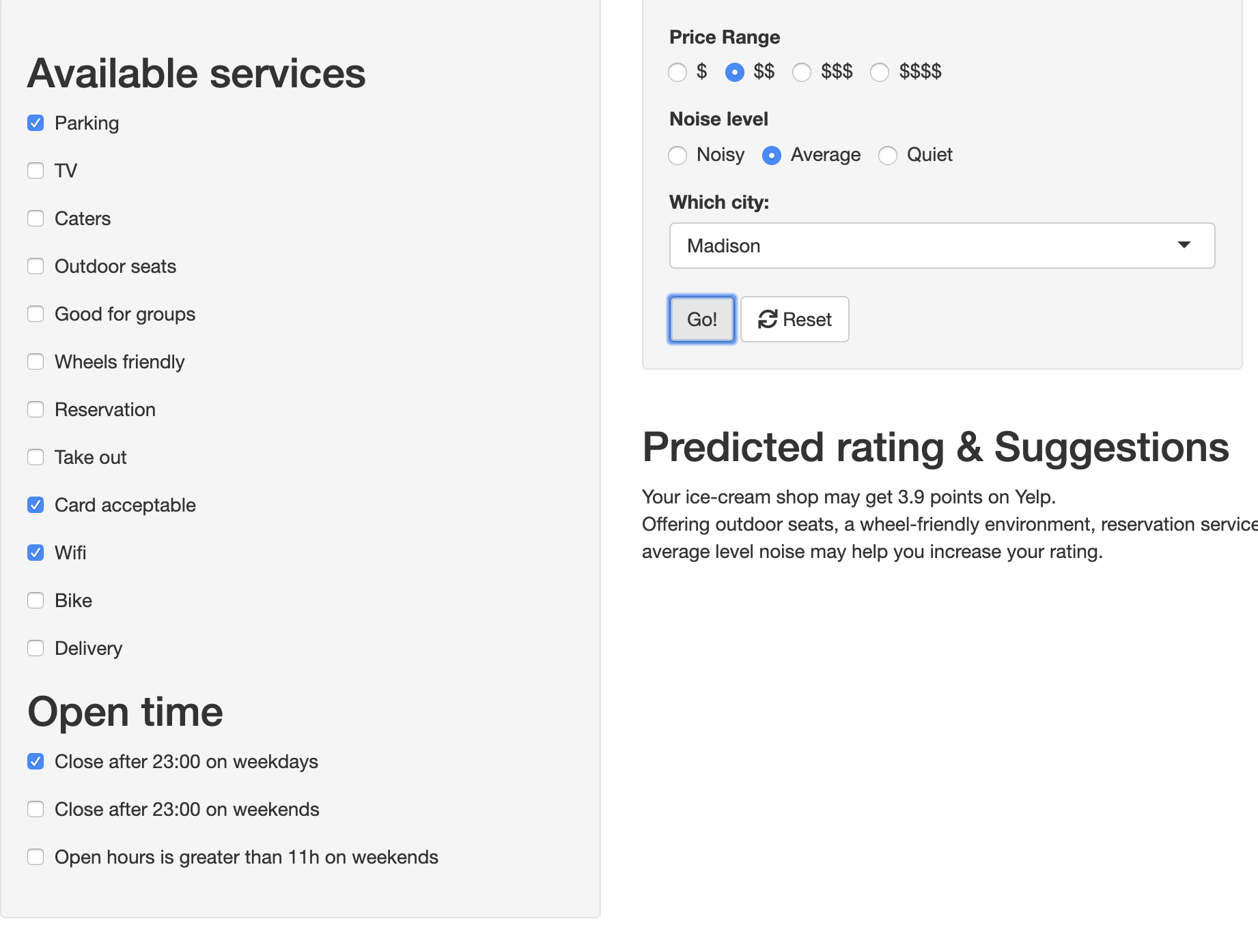

Conclusion (Star prediction)
Predicted rating: 3.9
Suggestions: Offering outdoor seats, a wheel-friendly environment, reservation service, take-out service, delivery service, lower price, an environment with average level noise may help you increase your rating.

Slide 15
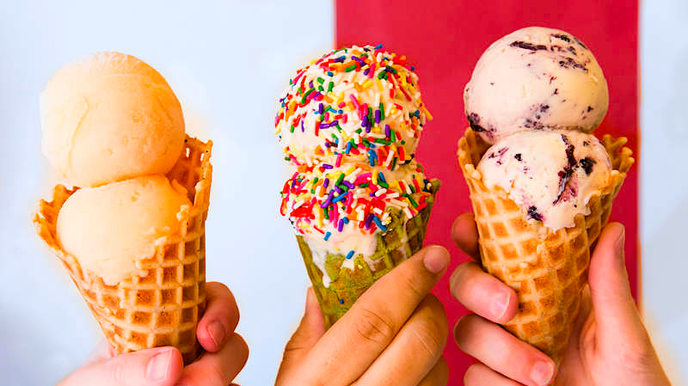
THANKS Q & A

